Slide 1

Rebuilding Trust: A Shared Foundation for Resilient Food Systems
Notes:
Welcome, and thanks to all over100 people from across the sector for being here.
Today, I’m excited to walk you through something we’ve talked about with many of you and that many of you have asked for—Canada’s Food System: a coordinated, research-driven Public Awareness Initiative designed to speak directly to Canadians about why our food system matters.
You’ll see what it is, why it’s needed, and most importantly—how you can be part of it.

Slide 2

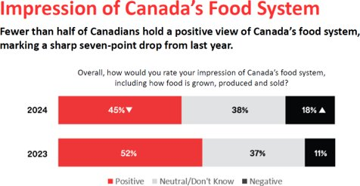
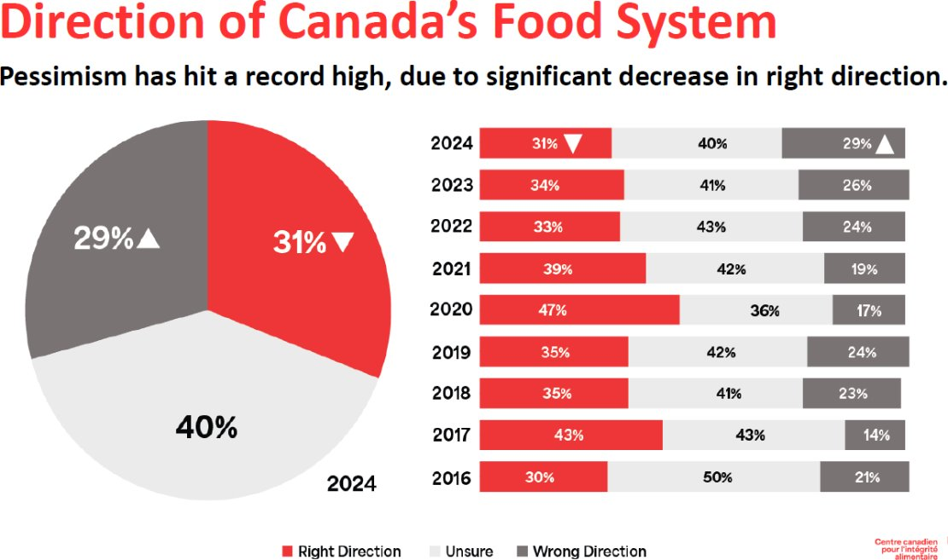
The Problem That Led Us Here
Despite individual efforts across the value-chain, the perception of how food gets from the farm to a consumer's plate, as well as key trust indicators dropped dramatically.
Notes:
When we started consulting on this initiative, our Public Trust Research showed a troubling trend: despite all the good work being done, public trust in the food system was declining.
Trust is fragile—and global uncertainty and misinformation only make it harder to maintain.

Slide 3
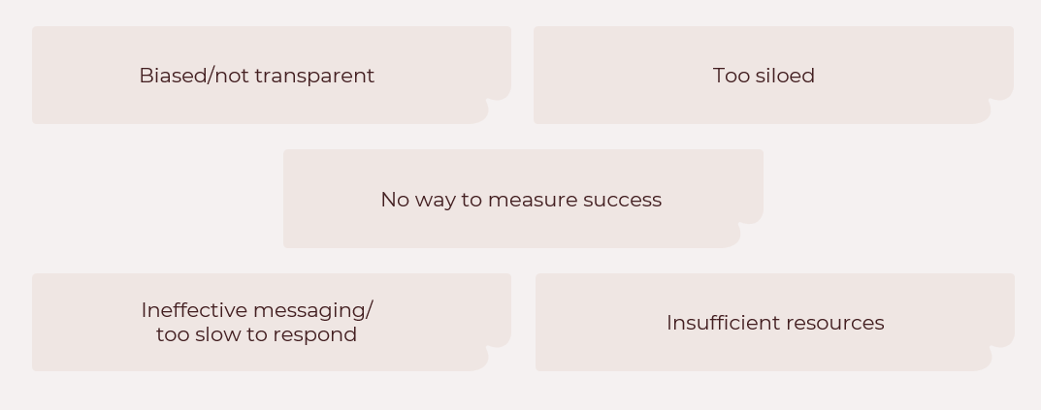
Why Hadn’t Our Efforts Worked?
Notes:
We asked ourselves: why haven’t past efforts worked? And the answer is clear—Canadians see a fragmented picture.
We’ve educated, but we haven’t connected. We’ve informed, but we haven’t inspired. And we’ve never told one, unified story about the food system—at scale.

Slide 4
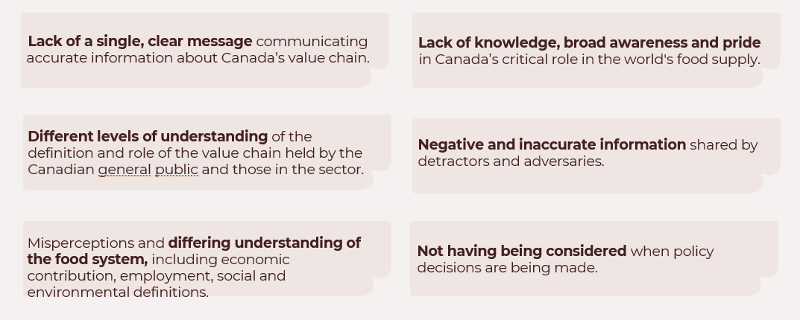
Challenges
Notes:
There’s a lack of public understanding of how the food system works – and who’s in it. Most Canadians don’t realize how far the system extends -and all the people who make it work.
They don’t see the economic, social, and environmental contributions it makes.
Meanwhile, misinformation spreads – sometimes out of confusion, sometimes deliberately. And too often, we’re left out of the rooms where big decisions are made.

Slide 5
Message Received:
Public Awareness AND
Public Relations Influence
The sector supports a public awareness campaign but wants to ensure that there is an element of public relations/policy influence, not a lobbying effort, but one that ensures that policymakers understand that Canada’s food system is recognized as a key economic and social driver.
Notes:
Back in 2023, in our initial consultations with the sector, and up to now, we have overwhelmingly heard that yes, we need public awareness, but we need more.
This initiative also needs to shape public understanding in a way that softens the ground for policy discussions. That creates something that policymakers will have seen. That you can reference in your efforts to get to the table when the big decisions are being made.
Not lobbying. But smart, credible influence that positions Canada’s food system as a national asset.

Slide 6
Global Pressures Create an Attitudinal Shift
This is a critical moment for Canada’s Food System
Tariffs may increase costs, restrict market access, and destabilize Canadian businesses, putting significant strain on farmers and food producers.
They threaten to force layoffs, stall investment and weaken rural economies, risking 2 million jobs linked to the food system.
They can lead to long-term regulatory challenges, reducing investment in innovation and weakening Canada’s global position in agriculture and food production.
They can disrupt supply chains and erode consumer confidence in cross-border trade and elevate food safety concerns.
Amid these challenges, a strong, pro-Canada sentiment is taking root.
Canadians are rallying behind the food system—recognizing its value, resilience, and importance to national prosperity.
This is a pivotal moment to harness that support, strengthen public trust, and build lasting momentum.
Notes:
Global uncertainty has shaken a lot of things, but it’s also sparked something important: a rise in national pride.
Canadians want stability. They want to support what’s Canadian.
This is our window to turn that instinct into lasting public trust in Canada’s food system.

Slide 7

The time has come to create a Movement, not just a Moment.
Notes:
This isn’t about a seasonal initiative or a clever slogan.
This is about building a cultural shift, a lasting movement rooted in pride, understanding, and trust.

Slide 8
What Are We Trying To Do?
Elevate Canada's food system and agriculture to a core societal value (comparable to health care and education) among Canadians that compels engagement and efforts to sustain it.
1
Reverse indifference and enhance public trust in all parts of Canada's food system, ensuring it stays prominent in the minds of consumers and policy makers alike.
2
Deepen public understanding of the food system’s importance while underscoring the need for sustained, meaningful engagement.
3
Notes:
So, what are we trying to do?
We need to:
Elevate the food system and agriculture to a core societal value, like healthcare or education.
Reverse indifference and build public trust.
Deepen understanding of the system’s value.
This initiative is about placing the food system at the center of Canada’s identity.

Slide 9
Gut Check – Do Canadians Want This? Yes.
In March 2025, a national survey was conducted to support the development of
a public awareness campaign about Canada’s food system.
82% say Canada’s food system is important to them
82% are interested in learning more about it
86% believe this kind of campaign would improve their trust in the food system
Only 33% agree that Canada’s food system should not be a priority right now
*source: Ipsos
Canadians expressed widespread support for
the campaign’s intent:
Notes:
Then, it was time to take a breath. We asked ourselves: Do Canadians even want this?
So, we asked them.
And the answer is yes.
Our Ipsos survey results, taken last month, are clear:
82% say the food system is important to them.
86% believe this kind of initiative would increase their trust.

Slide 10

Innovation: A Unifying Narrative
Unifies the sector
Core to Canada's food system: drives resilience, adaptation, and prosperity
Unifying, forward-looking message Canadians support—linked to solutions, sustainability, and jobs
But: “Innovation” alone can feel abstract or risky to consumers, so we must focus on outcomes: what does our ability to innovate deliver for Canadians?
Message strategy:
  Innovation is the means, not the message
  Ground in real-world examples
  Leading with benefits builds trust
Final Takeaway:
Outcomes Are the Hook, Trust Is the Goal
Notes:
In a sector whose members all have their own priorities and needs, we looked to find the areas of commonality.
Innovation is one of the factors that unites our sector. We’re all doing it: It’s central to our food system – and to this initiative.
But our research shows that talking to Canadians about “innovation” can be scary – they don’t like it when we appear to be messing around with their food, or doing things solely for profit – that’s NOT what we do.
The research shows that we need to talk to Canadians about innovation in terms of what that innovation gives THEM.
We’re not leading with jargon or tech terms. We’re leading with what innovation delivers: better food, stronger sustainability, improved lives. Outcomes are the hook. Trust is the goal.

Slide 11


Introducing
Our Food. Our Future.
Notes:
So, with that, I introduce (or re-introduce you) to Canada’s Food System: Our Food. Our Future.

Slide 12

‘Canada’s Food System’ –
Tested and Resonant
Rooted in message testing: Outperforms other terms in public opinion research
Broad and inclusive: Covers the full value chain, from farm to table
Resonates emotionally: Taps into national pride and shared responsibility
Backed by research: Canadians prefer collective, pro-Canada language—especially during times of economic uncertainty
Builds long-term recognition: Consistent use helps position the food system alongside healthcare and education as a core pillar of Canadian life
Notes:
We tested a lot of language with Canadians, and this one stood out: Canada’s Food System.
It’s broad, inclusive, and emotionally resonant. It speaks to every part of the value chain—and it taps into growing national pride, and helps position the food system as a core part of Canadian life.
It’s not just effective, it’s strategic. And it gives us a foundation we can build on for the long haul.

Slide 13
‘Our Food. Our Future.’ –
Also Tested and Resonant
Slogans Tested:
“Canada’s Food System: A promise on every plate.”
“Canada’s Food System: Your Food. Canada’s Promise.”
“Canada’s Food System: Your Food. Our Promise.”
“Canada’s Food System: Our Food. Our Canada.”
“Canada’s Food System: Our Food. Our Future.”
“Our Food. Our Future.” has a slight overall edge in both likeability and relevance.
Was the highest-rated across most demographics
Emphasizes a forward-looking message that resonates strongly with Canadians
Appeals to a broad audience while highlighting the importance of the food system in shaping the future
Aligns with the campaign’s goal of building long-term public trust
The statistical edge, long-term viability, and emotional resonance of “Our Food. Our Future.” make it the stronger choice for national rollout.
Notes:
We also tested multiple slogan options with Canadians to see what really landed. And this one, ‘Our Food. Our Future.’ rose to the top.
It was the highest rated across most demographics.
It invites people to think about where we’re going, not just where we’ve been. And it frames the food system as something we all share responsibility for.
The message is simple, but the impact is powerful. It says: this is ours, and what we do next matters.

Slide 14
Research and Testing –
At the Heart of this Campaign
As the last few months have shown us, global and national events can change the public landscape. This may cause us to pivot our strategy, but our goals to elevate the Canadian food system remain.
This initiative is flexible and adaptable to changes in the environment. We continuously test, react and adapt through:
Slogan testing
Key message testing
Ipsos polling
CCFI research
News monitoring
Social media listening
Measuring results and adjusting campaign tactics
Notes:
The fact is that this entire initiative is grounded in research and built to evolve.
We’re not guessing. We’re always testing: messages, slogans, platforms, and engagement tactics.
And we’re testing resonance and engagement to make sure we’re hitting the right note, in the right places, at the right times.
We’ll continue listening, learning, and improving. This will keep us agile.

Slide 15
Building The Movement
PHASE 1: The First 100 Days—Laying the Foundation for Our Food. Our Future.
Define Canada’s food system and say that this is more than a supply chain; it’s our lifeline.
Build public awareness by reinforcing its role in feeding communities, driving innovation, and securing our future.
Establish an emotional, pride-driven connection between Canadians and their food system.
Engage media, industry voices, and early advocates to spark momentum.
Call to Action: A profound and enduring pledge to protect the Canadian food system.
PHASE 2: Our National Cornerstone of Canada Campaign—Expanding Our Reach
Move from foundation to campaign, momentum to nationwide impact—reaching Canadians at both national and regional levels.
Mobilize all Canadians to recognize, protect, and champion the food system for their future.
Position the system as a pillar of national strength—on par with healthcare and education—while recognizing the distinct realities of each province and region.
Leverage national pride and sovereignty concerns to elevate its importance for consumers and policymakers.
Notes:
Phase 1 is our First 100 Days.
It’s all about building a foundation: defining the food system, creating an emotional connection, and activating media, industry, and public support.
In Phase 2, we grow.
We scale nationally, integrate regional stories, and position the food system as a Canadian pillar – a part of the Canadian identity, a part of who we are – and position ourselves as important, nay critical, to our nation.

Slide 16
The First 100 Days:
Beginning May 15, 2025
Notes:
It all starts May 15.

Slide 17
The Public Engagement
Strategy

Slide 18
What We’re Getting Across
Our food system is the cornerstone of Canada—powering our economy, driving innovation, and securing our future. But before we get there, the first 100 days of this campaign must focus on who we are and why it matters.
More than a supply chain, we are Canada’s lifeline—sustaining communities and connecting us to the world.
Behind every plate is a nation at work – here and around the world: from agriculture and aquaculture to transportation, science and innovation, manufacturing, processing & assurance systems to retail and foodservice.
Our Food. Our Future.
Notes:
Before we can tell the whole story, the first 100 days of this initiative need to focus on something even more foundational—who we are, and why we matter.
We’re not just a supply chain. We’re a lifeline.
We sustain communities, feed families, create opportunity, and connect Canada to the world.
And behind every plate is a system powered by people, a full spectrum of Canada at work.
This is what we need Canadians to understand. And once they do, we can start to change not just perception—but policy and culture, too.

Slide 19



Audiences and Platforms
Our primary audience, Gen X and Boomers, are most active on Facebook, where they seek out news, community discussions, and educational content.
Millennial parents engage more on Instagram where visual and shareable content resonates. X (formerly Twitter) will serve as a space for real-time engagement with audiences and brands. Bluesky is also a fast- growing, engaged platform and will serve as an ideal place in reaching early adopters to build authentic community.
We will tailor our content approach slightly to each platform's audience and strength to create a meaningful dialogue, build trust and encourage Canadians to engage with the food system in a new way.
Notes:
We’re meeting Canadians where they are.
Each platform will carry its own tailored content.
New audiences will come in the second phase.

Slide 20
Pillar One
Let's talk about
Canada’s Food System
Canada’s Food System has always been there for Canadians and will continue to be. And with Canadian food on everyone’s minds, we see this as the perfect time to re-ignite the conversation.
Canada’s Food System is not new; it’s a constant. And we can’t wait to remind Canadians of the network of people, businesses, and communities that grow, produce, prepare, and deliver the food they eat every day.
Notes:
The first 100 days are built on five pillars.
We’re bringing to the foreground a conversation that’s been quietly happening in the background for years.
This first pillar is all about opening that door. Reminding Canadians that behind every bite of food is a vast, interconnected network of people, businesses, and communities working together.

Slide 21
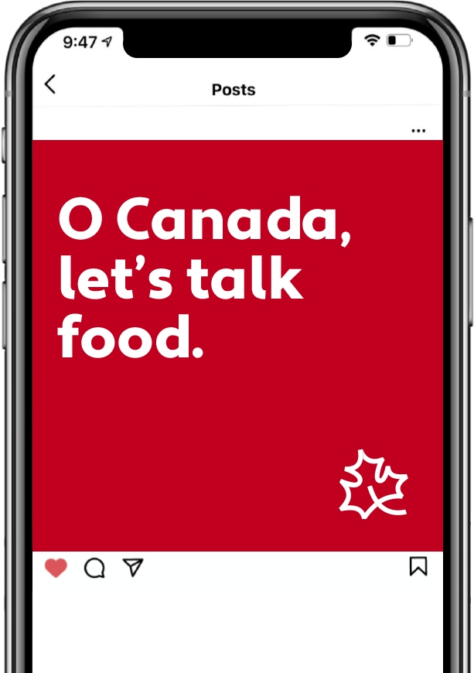


Sample Post - Introduction to
Canada’s Food System
Post copy:
Our food system always has, and always will be,
an essential part of Canada. But right now, we hear the important questions you're asking and want to be a part of the conversation! We're here to help you find trusted answers and reconnect you with the hard-working people that feed our country.
Follow along as we unpack Canada's Food System. #OurFoodOurFuture
Leaf animates in corner (matching manifesto video)
Text on image:
O Canada, let's talk food.
Our food system always has, and always will be, an essential part of Canada. But right now, we hear the important questions you're asking and want to be a part of the conversation! We're here to help you find trusted answers and reconnect you with the hard-working people that feed our country.
Follow along as we unpack Canada's Food System. #OurFoodOurFuture
Notes:
We’ll start with warm, approachable content that breaks the ice and invites trust.
It also builds on the sense of Canadian pride – invoking Canadian iconograpy.

Slide 22
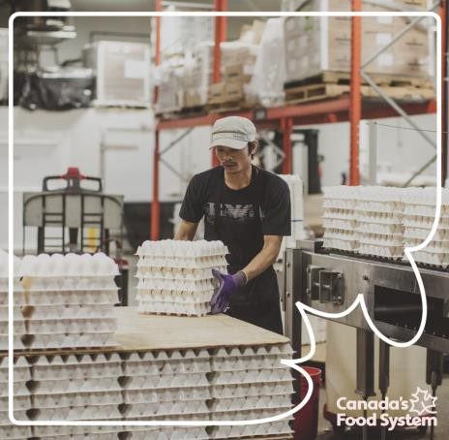

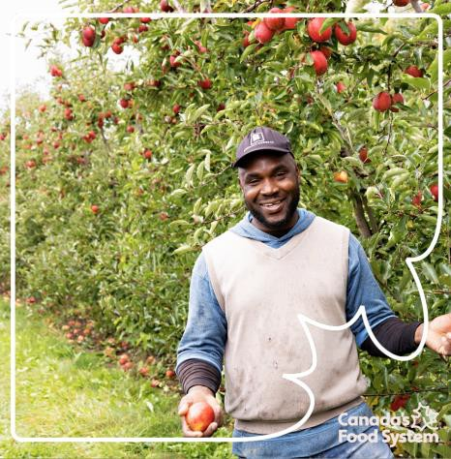

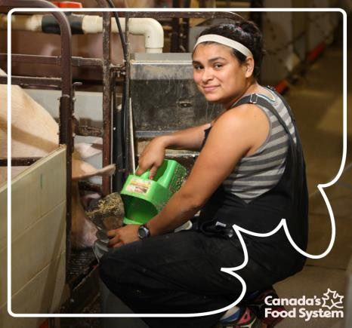
Sample Post - Alt
Post copy:
Our food system always has, and always will be, an essential part of Canada. But right now, we hear the important questions you're asking
and want to be a part of
the conversation! We're here to help you find trusted answers and reconnect you with the hard-working people that feed our country.
Follow along as we unpack Canada's Food System. #OurFoodOurFuture
Text on image:
O Canada, let's talk food.
Animated GIF – Rolls through imagery. Quick, punchy, covering lots of sectors
Image source: client-provided
Our food system always has, and always will be, an essential part of Canada. But right now, we hear the important questions you're asking and want to be a part of the conversation! We're here to help you find trusted answers and reconnect you with the hard-working people that feed our country.
Follow along as we unpack Canada's Food System. #OurFoodOurFuture
Notes:
We’ll mix formats and designs, keeping content dynamic but consistent.
Repetition builds recognition.

Slide 23
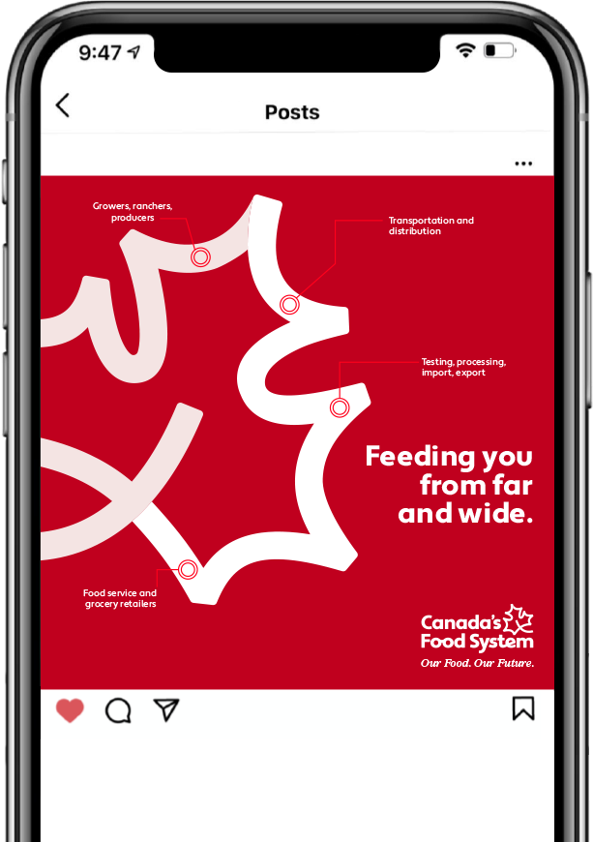

Sample Post – Gate to Plate Journey
Post copy:
From midnight snacks to picnics in the park, Canada’s Food System is behind every bite! Every farmer, food packer, chef, and transport truck driver play a part in making sure your food reaches your fork fresh and delicious.
Follow along as we share more about who's behind
Canada’s Food System. #OurFoodOurFuture
Text on Image:
Feeding you from far and wide.
Growers, ranchers, producers Transportation and distribution Testing, processing, import, export Food service and grocery retailers
From midnight snacks to picnics in the park, Canada’s Food System is behind every bite! Every farmer, food packer, chef, and transport truck driver play a part in making sure your food reaches your fork fresh and delicious.
Follow along as we share more about who's behind Canada’s Food System.
Notes:
We’ll take Canadians through the gate-to-plate journey – and spotlight the people along the way.

Slide 24

Pillar Two
Pledge Your Support
Canadians are already showing up for Canada's Food System – and with a draw rooted in audience engagement launching soon, we have an opportunity to amplify the message on social media and drive participation from day one.
The primary portion of the draw will live on the landing page and will be rolled out in social posts with a CTA for the user to voice their support for Canada's Food System, all for a chance to win a $500 gift card to a Canadian retailer of their choice.
A chance at a bonus entry will follow shortly after and will meet people where they already are – in the grocery store, the market, or at home preparing a meal. We'll encourage Canadians to share photos of a meal they've made, tagging @canadasfoodsystem and using our digital sticker: "I support Canada's Food System". To be fully eligible they must sign their support on the landing page as well.
The social layer can run in tandem with the website campaign and act
as a steady drumbeat of engagement.
While contests alone don't build deep trust, this gives us a way in – to celebrate everyday choices, encourage participation and open the door to bigger conversations around food security, sustainability and supporting Canadian.
Notes:
One of the most important things we can do in any movement is give people a clear, simple way to engage. Something they can do, not just read about.
That’s why this pledge is such a vital part of the initiative’s early days.
Canadians already care—but many don’t know how to show it. This gives them a way in. It gives them a role. It says: you’re part of this too.
The pledge lives on our landing page and will be promoted across social media with a contest. It’s a light touch—a chance to win a $500 gift card—but it opens the door to something bigger.
Our website will serve as the central hub for the initiative—a launching point that connects Canadians to the best content, tools, and stories already being shared across the sector.
We’ll follow that with a bonus entry that invites Canadians to share food moments from their own lives. A meal they’ve made. A trip to the grocery store. It brings the message home—literally.
Because while contests don’t build deep trust on their own, they’re a powerful entry point. They create visibility. They spark conversation. And they invite people to move from passive observers to active participants.
That’s how we begin to shift culture—one small action at a time.

Slide 25


Influencer and Partner Engagement
To build trust and expand our reach, we will engage smaller-scale influencers with deeply engaged audiences and trusted food backgrounds – like essential partners, partner organization, dietitians, chefs and other advocates connected to the food system.
Many of these creators are already in our orbit through partners like Canadian Food Focus and Farm and Food Care Ontario, giving us a direct line to passionate, credible voices.
These influencers will help amplify the "I support Canada's Food System" message by sharing their own experiences in purchasing and cooking, and encouraging their communities to join in. Their authentic perspectives will help spark participation in the competition, drive traffic to the pledge and spread awareness in a way that feels organic and trustworthy.
This isn't about traditional paid brand placements. It's about partnering with people who genuinely care about educating and empowering Canadians to think more critically about what they eat and where it comes from.
*photo credit – www.farmphotos.ca
Notes:
When we talk about influencers in this initiative, we’re not talking about celebrities or big paid initiatives.
We’re talking about real people with real credibility who already have trust with their audiences.
And often, the people inside your own organizations are the most compelling storytellers. They’re relatable, they’re passionate, and they already speak from experience. If you have someone who can carry your message, we want to work with them.
What matters most is authenticity. These voices will share their real experiences. And in doing so, they’ll invite others to do the same.

Slide 26
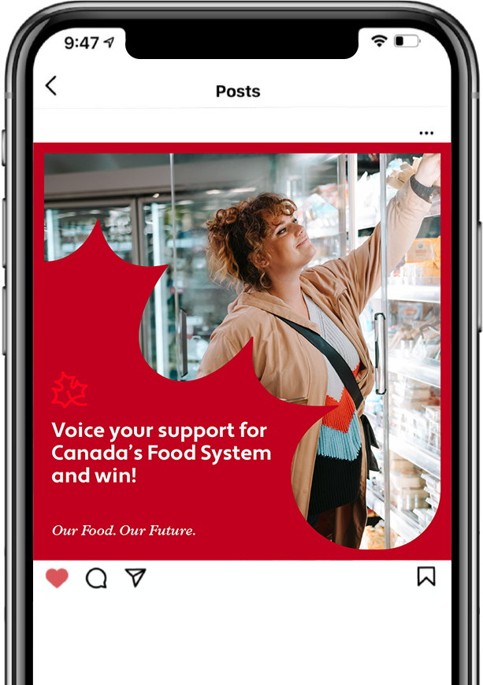

Sample Post –
Contest Introduction
Post copy:
Voice your support for Canada's Food System for the chance to win a monthly $500 gift card to a Canadian retailer of your choice!
Show up for the hard-working people behind every meal AND get the chance to continue buying the Canadian products you love with a $500 gift card. Entering our draw is as easy as voicing your support at the link in our bio.
#OurFoodOurFuture
*Insert contest legalities/logistics at a later date.
Text on Image:
Voice Your Support for
Canada's Food System and win!
Our Food. Our Future.
Voice your support for Canada's Food System for the chance to
win a $500 gift card to a Canadian retailer of your choice!
Show up for the hard-working people behind every meal AND get the chance to continue buying the Canadian products you…
Notes:
This is what one of those pledge posts will look like—inviting, easy to understand, and built to share.
We’re making the ask simple: engage, share, and stand behind the food system.

Slide 27
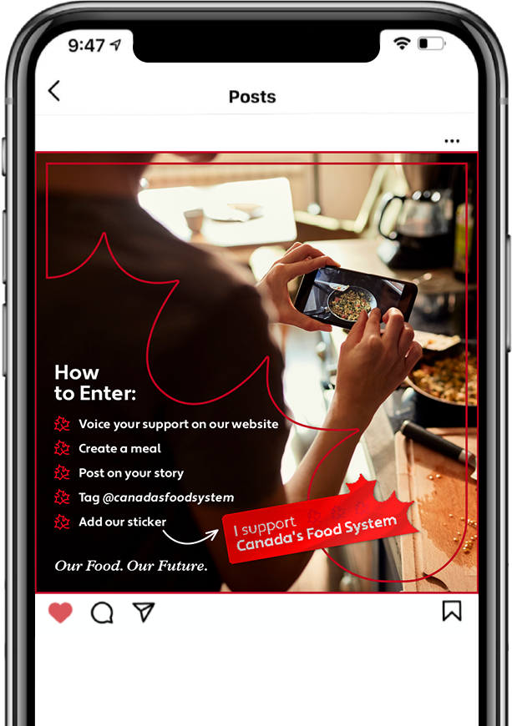





Sample Post –
Bonus Entry
Post copy:
Bonus Entry Alert
Want another entry into our monthly draw for a $500 gift card to a Canadian retailer of your choice? It's as easy as cooking up a meal with products from Canada's Food System — that's anything from your
grocery store!
Share a photo on your story of a meal you've cooked
Tag @canadasfoodsystem
Add our custom sticker to your post.
Make sure you've voiced your support for Canada's Food System at the link in our bio to be eligible!
Every month, we'll randomly pick a new winner. We can't wait to see
what you make!
#OurFoodOurFuture
*Insert contest legalities/logistics at a later date.
Text on Image:
How to Enter:
Voice your support on our website
Create a meal
Post on your story
Tag @canadasfoodsystem
Add our sticker
Bonus Entry Alert
Want another entry into our monthly draw for a $500 gift card to
a Canadian retailer of your choice? It's as easy as cooking up a meal with products from Canada's Food System — that’s…
Notes:
As a next step, Canadians will be invited to share a meal made with Canadian ingredients. It’s a light lift that builds emotional connection.
These moments are powerful because they’re relatable. Everyone eats. Everyone has a food story.

Slide 28


User Generated Content
To continue promoting the contest, we’ll re-share user-generated content and influencer content, creating an authentic tone through our platforms.
Notes:
When Canadians respond, we’ll amplify. This is how we build momentum.
When people see their content shared, they feel seen. It shows that this isn’t just a broadcast—it’s a national conversation.

Slide 29
Pillar Three
Stories
To create a deeper emotional connection with Canadians, it's important we showcase the real people who contribute to feeding us – from farmers and grocery store workers to parents making food choices for their families. Their stories will bring to life the hard work, dedication, and everyday decisions that shape Canada's Food System.
We have a strong foundation to build on, with existing YouTube footage providing a starting point for storytelling. From there, we can expand the narrative, capturing diverse perspectives across the food system.
Farmers will share their experiences growing the food we eat, grocery store workers can speak to how they get that food to our tables, and families can reflect on the choices they make to support Canadian products. We’ll also showcase the stories behind classic Canadian dishes - the journey and origins of the ingredients that bring these meals to life.
Through short-form videos and inspiring images, we will create content that is engaging, relatable to many, and shareable. Ultimately, we are reminding people of the human effort behind every meal.
Notes:
This pillar is about showcasing the real people across the system. These stories will highlight the effort, decision-making, and pride that shape Canada’s Food System every day.
We’ll build on existing content and expand the narrative from there. Everyone has a role, and everyone has a story.
At its heart, this pillar reminds people that every meal is made possible by your hard work. And that’s something worth recognizing—and protecting.

Slide 30
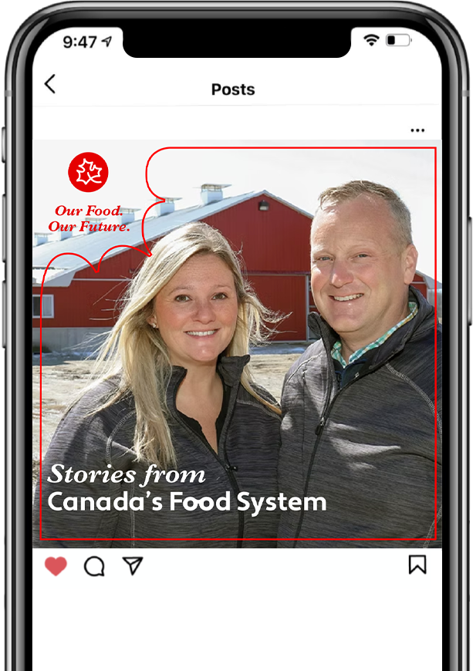
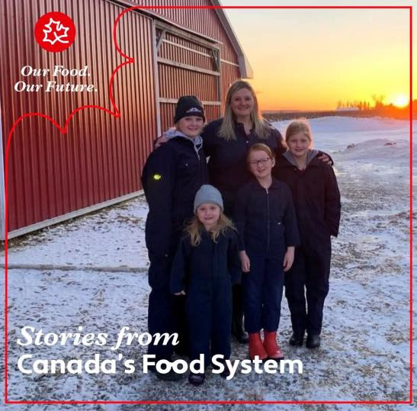
Sample Post – Stories from
Canada’s Food System
In-feed Post Copy:
In Canada, 90% of farms are family-owned, meaning farming isn’t just an industry, it’s a legacy. Kathryn Doan from Norwich, Ontario's Doan Family Turkey Farm shares her passion for farming and its importance to her family.
Hear more stories from the hard-working people behind Canada's Food System at CanadasFoodSystem.ca
#OurFoodOurFuture
Video Clip 0:00-0:24
“Welcome to Doan Family Turkey Farm. I'm
Kathryn Doan I am a mother of four and a first- generation turkey farmer. As a mother and a turkey farmer, I care about having safe, quality, nutritious food to be able to choose in the grocery store and for my family to eat just like yours.”
Alt
In Canada, 90% of farms are family-owned, meaning farming isn’t just an industry, it’s a legacy. Kathryn Doan from Norwich, Ontario's Doan Family Turkey Farm shares her passion for farming and its…
Notes:
Take Kathryn, for example—a turkey farmer and a mother.
Her story speaks to dedication, values, and the everyday work of feeding Canadians.
These aren’t just roles.
These are real people—and real reasons to be proud.

Slide 31
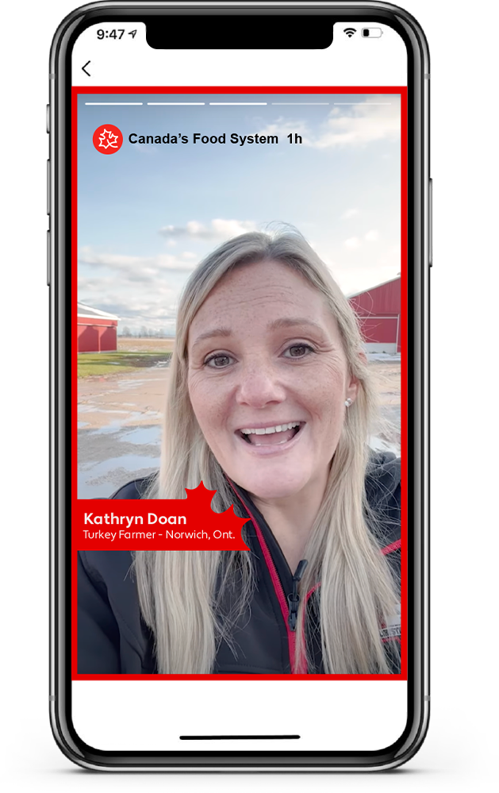
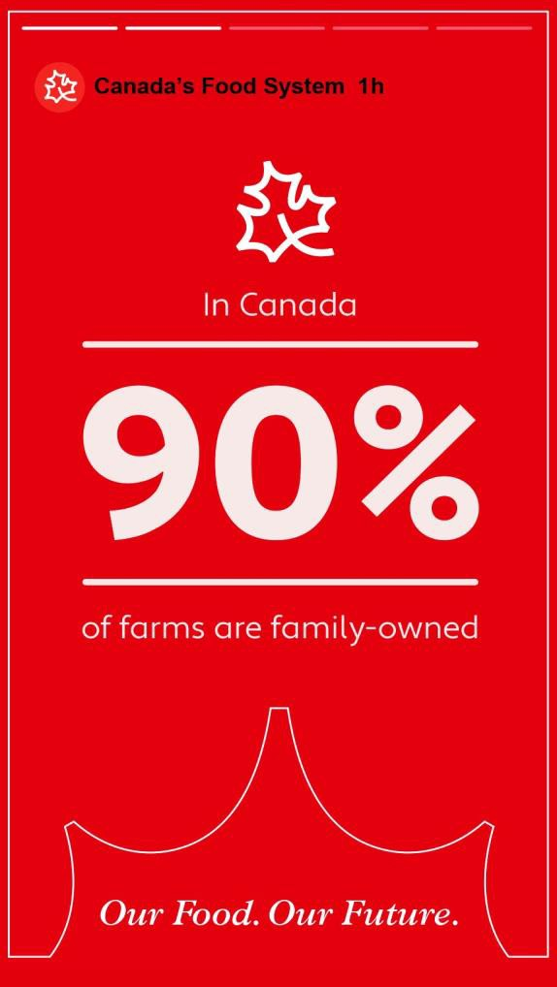
Sample Post – Stories from
Canada’s Food System
Text on Image:
In Canada 90% of farms are family owned
Our Food. Our Future.
Kathryn Doan
Turkey Farmer – Norwich, Ont.
Notes:
And we’ll use these times to introduce facts about our sector and its amazing contributions to Canadian life.

Slide 32
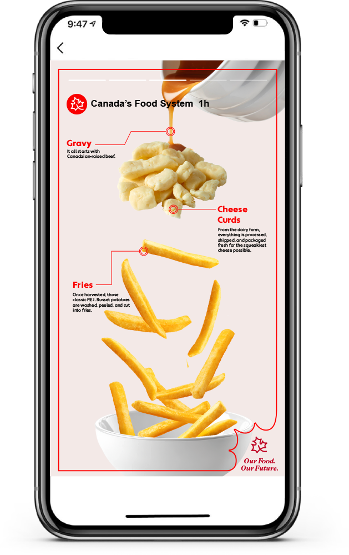

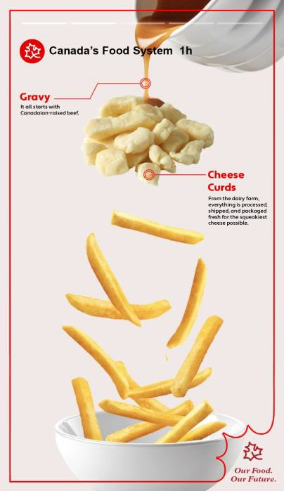

Sample Post – Stories from
Canada’s Food System
Text on Image:
Gravy
It all starts with Canadian-raised beef.
Cheese Curds
From the dairy farm, everything is processed, shipped, and packaged
fresh for the squeakiest cheese possible.
Fries
Once harvested, those classic P.E.I.
Russet potatoes are washed, peeled,
and cut into fries.
*stock images will be replaced by industry-provided images
Notes:
We’ll also show how food comes together—visually mapping where each part of a dish originates.
It’s a simple way to demonstrate scale and coordination.
Even a basic meal like poutine becomes a story of connection to Canada’s food system.

Slide 33
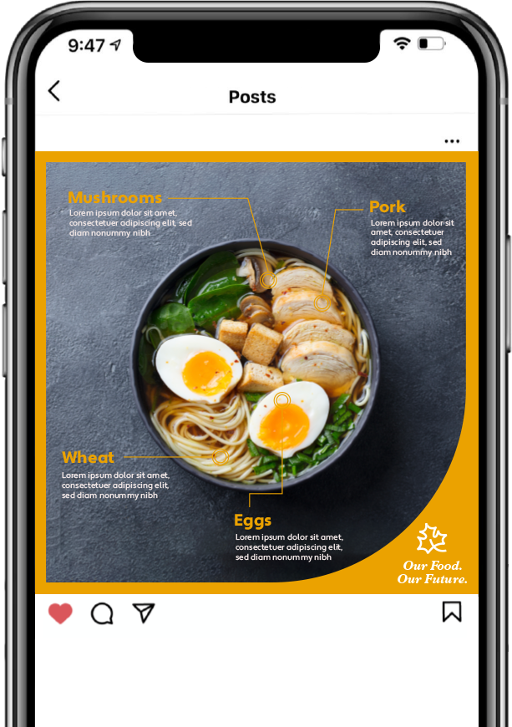



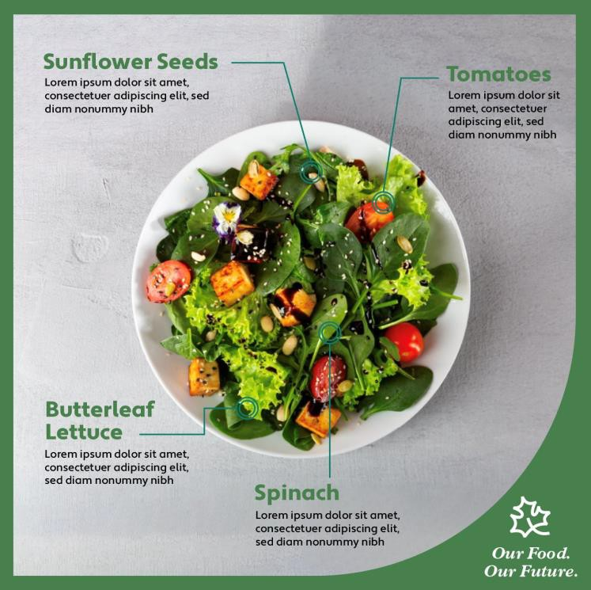
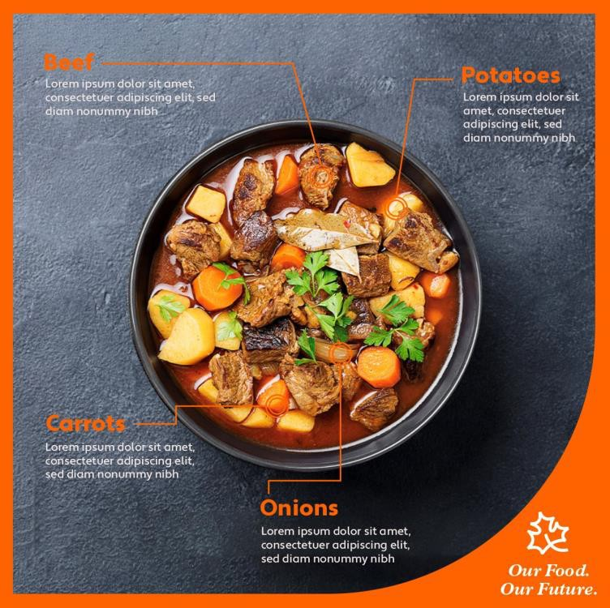
Sample Post – Stories from
Canada’s Food System
Post Copy:
Ever wonder how your favourite meal makes its way to your plate? There may be more that goes into it than you think!
#OurFoodOurFuture
*stock images will be replaced by industry-provided images
Ever wonder how your favourite meal makes its way to your plate? There may be more that goes into it than you think!
Notes:
And we’ll make sure this includes the full range of Canadian food experiences.
From cultural favourites to regional staples—we’ll reflect Canada’s diversity and help people see their food, their traditions, in this initiative.
These shots are stock – we’ll feature Canadian content – your content, if you have it and want to share it – and bring your associations, recipes, products, and content to the forefront.

Slide 34
Pillar Four
Economy & Jobs
Canada's Food System is more than farms and grocery stores, it's a massive economic driver, supporting millions of jobs in ways people don't always realize.
We will highlight the unsuspecting careers within Canada’s Food System, showcasing the hidden network of jobs that keep it running. A dedicated content series will explore roles people may not associate with food production – like truck drivers, data analysts or even refrigeration technicians – giving credit to those who play a vital role in feeding Canadians.
To spark engagement, we could introduce interactive content like polls asking audiences whether they think certain jobs are part of the food system. Many people may not even realize their work connects back to food production and the economy, creating an opportunity for education and discovery.
By sharing these stories, we will reinforce how deeply connected the food system is to Canada's workforce and economy, helping Canadians see its impact in their own community, and maybe, in themselves.
Notes:
As you know, Canada’s food system is one of the biggest economic engines in the country—but most people don’t see the full picture.
They might think about farms and grocery stores, but the reality is much broader. It’s logistics, engineering, science, IT, communications, retail, hospitality, and so much more. Millions of jobs—many of them unexpected—are tied to this system.
This pillar is about giving visibility and credit to those roles. We’re shining a light on the hidden network of people who keep food flowing across the country.
And by sharing these stories, we reinforce something important: the food system isn’t some distant, abstract thing. It’s local. It’s essential. It’s personal.

Slide 35
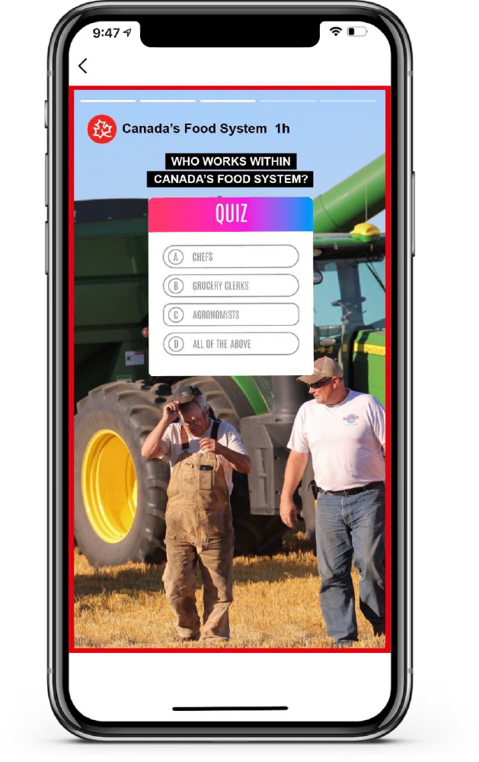
Sample Post – Story Poll
On image copy:
Who works within Canada's Food System?
QUIZ:
Chefs
Grocery Clerks
Agronomists
All the above
Notes:
Posts like this get people thinking. ‘How many jobs are connected to food?’ Most people guess far too low. When they learn the truth—it’s eye-opening.
These aha moments are exactly what we’re aiming for.

Slide 36
Pillar Five
The Future of Food
Canadians care deeply about where their food comes from and that’s something we respect. While questions about farming practices, food quality and modern techniques are common, what’s often missing from the conversation is all the good that’s already happening in our food system.
Rather than talking about innovation, we’ll focus on the outcomes Canadians can see and feel. More nutritious food, improved sustainability, stronger support for farmers and a more secure food supply. Through expert voices, real-world stories and everyday examples, we’ll bring to life how these improvements are already shaping a better future for food in Canada.
Our content will be educational, approachable, and grounded in real benefits not buzzwords. We’ll help people understand how progress and practical solutions are working together to grow, produce and deliver food that meets the needs of today and tomorrow.
This isn’t about convincing people to accept change, it’s about showing them the results
of it. When they see the outcomes, the trust will follow!
Notes:
This pillar focuses on helping Canadians see that the future of food isn’t some distant concept—it’s already being built, right now.
Instead of leading with jargon or buzzwords, we’re going to focus on outcomes: better nutrition, stronger sustainability, a more secure food supply.
And we’ll keep it grounded. Educational, yes—but always clear, approachable, and human.
Because this isn’t about convincing people to accept change. It’s about showing them the results of that change. And once they see those outcomes—the trust will follow.

Slide 37
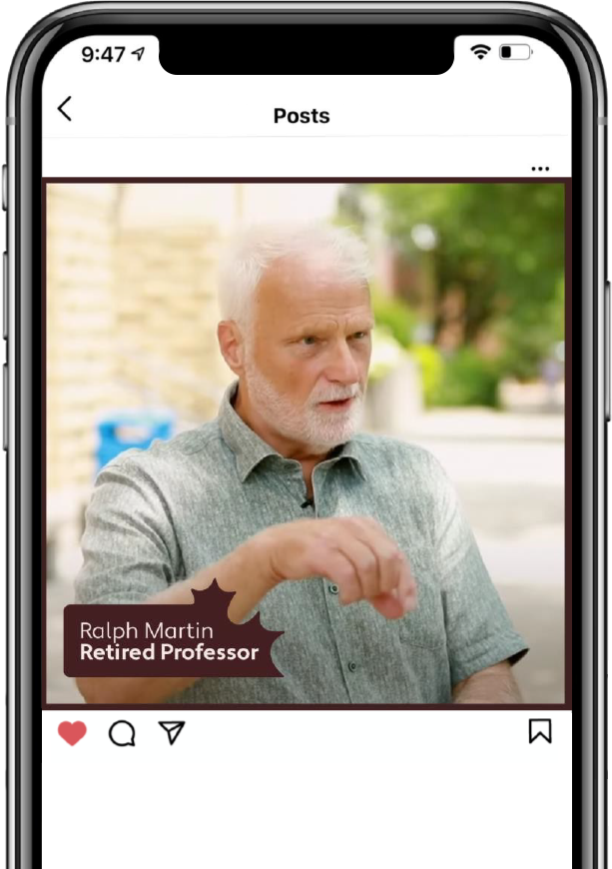
Sample Post –
The Future of Food Video
Post Copy:
Canada’s Food System grows, produces, distributes, and cares for everything you put on your plate. Since we're feeding more people now than ever before, our food system is constantly looking for ways to improve food quality and efficiency to ensure food security for generations to come. Learn more about the future of our food at the link in our bio.
#OurFoodOurFuture
Video frame 1
Video Clip 4:42-5:00 “It's really important that when we manage our soil that we have cover crops that we have soil amendments that we add to the so il that we look after the soil in such a way that we are increasing the soil organic matter so that it can be productive regardless of situations that happen with weather." https://www.youtube.com/watch?v=b8IpVe0QSAQ
Canada’s Food System grows, produces, distributes, and cares for everything you put on your plate. Since we're feeding more people now than ever before, our food system is constantly looking for ways to improve food quality and efficiency to ensure food security for generations to come. Learn more about the future of our food at the link in our bio.
Notes:
Here’s an example: a professor talking about soil health. It’s not flashy—but it’s incredibly powerful. It shows stewardship, foresight, and commitment to the next generation.

Slide 38

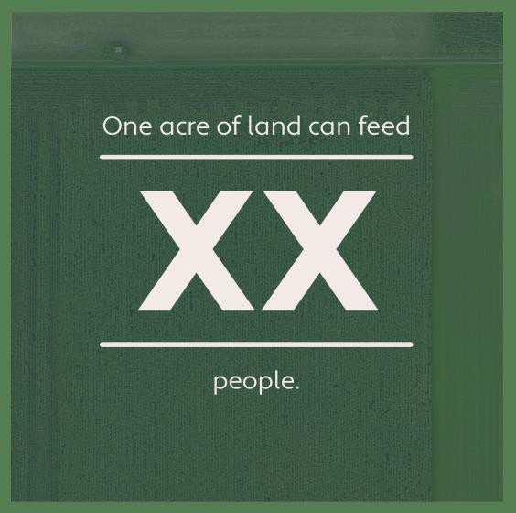



Sample Post –
Joining the Conversation
Post Copy:
Did You Know?
Canada's Food System feeds 400 million people a year! With more mouths to feed, our food system has to grow and evolve in new ways, like figuring out how to make the most of our land.
What are some things you'd like to see us unpack within Canada's Food System?
#OurFoodOurFuture
We’ll include posts about relevant topics to Canadians. These could come to life with graphics, real explanations from experts, or video segments.
Text on image:
O Canada, did you know?
One acre of land can feed X people.
That's X more than one acre could feed 10 years ago!
frame 2
frame 3
frame 4
Did You Know?
Canada's Food System feeds 400 million people a year! With more mouths to feed, our food system has to grow and evolve in new
Notes:
We’ll also use short, impactful facts to highlight the scale of Canada’s food system. For example, we feed 400 million people worldwide each year. That kind of stat reframes the conversation—suddenly, this we become even more important.

Slide 39
Policy Influence and Media Strategies

Slide 40
The First 100 Days – PR Influence
The first 100 Days will serve as the national launch point for a long-term initiative that positions Canada’s Food System as a vital national asset—essential to economic stability, food security, trade resilience, and innovation.
PR efforts will work from the central momentum being driven by the rising wave of national pride and a need to reframe Canada’s food system from overlooked infrastructure to a pillar of Canadian identity and resilience.
Notes:
Again, when we talk about PR influence, we’re not talking about lobbying. We’re talking about something more powerful—and more sustainable.
The first 100 days give us a crucial window to start shifting public perception in a way that naturally leads to political relevance.
Through the right messaging, storytelling, and strategic media, we’ll start to position Canada’s Food System as a pillar of national strength.
This part of the initiative lays the groundwork for all of that.

Slide 41
Public Relations Strategy
Public relations in this campaign is about more than visibility, it’s about creating a national platform that lifts the sector.
Through earned media, organic social, and a people-first audio docuseries, we will:
Tell compelling stories that connect Canadians to the people, progress, and pride behind their food
Position Canada’s food system as a vital, innovative, and resilient part of everyday life
Amplify the voices of partners—farmers, processors, researchers, advocates, and community leaders—already doing the work
Shape the public and policy narrative by showing how innovation and care are securing Canada’s food future
This campaign doesn’t just speak about the food system—it speaks with it.
Together, we’ll grow trust, engagement, and influence—one story at a time.
Notes:
This is about building a national platform that lifts the entire sector—by making the food system relevant, human, and essential in the eyes of Canadians and policymakers alike.
We’re using earned media, organic social, and even a people-first audio docuseries to do something more powerful than advocacy alone—we’re creating resonance.
We’ll tell stories that connect Canadians to the people and progress behind their food. We’ll show how innovation and care are already shaping a stronger food future.
Because when the public cares, policymakers pay attention. And when the system is seen as vital, innovative, and resilient, it’s far more likely to be protected, prioritized, and invested in.

Slide 42
Showcasing the Sector
A Shared Platform
for Collective Impact

Slide 43
Showcasing the Sector
This campaign is designed not just to raise awareness—but to elevate the work already being done across Canada’s food system. Our partners are not amplifiers of our message—they are the message. We will actively feature their work, share their stories, expand their audiences, and create new opportunities for visibility, collaboration, and impact—across both public engagement and policy influence.
Driving new audiences to your stories and tools
We will showcase existing work from across the sector:
Campaign social media
The campaign website (spotlight stories, curated feeds)
Podcast/docuseries
Media storytelling
Amplifying trusted, authentic voices already doing the work
We will collaborate to develop:
Co-branded blog posts, videos, and interviews
Behind-the-scenes stories from partner operations
Expert explainers and regional perspectives
Growing your audience
We will actively link back to your resources via:
Clear calls-to-action (CTAs) in web and social content
SEO-optimized storytelling
Dedicated partner features
Visibility and credit built into every touchpoint
We will embed recognition into:
“In collaboration with/Visit XX for more” tags
Partner sections on the website
Media appearances and reports
→ Growing your audience
Notes:
One of the most important things to clarify is this: this initiative doesn’t compete with your work—it elevates it.
Our goal is to amplify what’s already happening, your content, your stories, your impact.
We’ll be actively driving new audiences to the great work already happening across the sector, through social media, the initiative website, media storytelling, and more.
We’ll directly lift your tools and platforms using calls-to-action, SEO-optimized storytelling, and partner-specific features. That means new visibility, deeper engagement, and real audience growth for you.
We’ll also collaborate on co-branded posts, behind-the-scenes videos, expert explainers—making sure regional and operational stories get the spotlight they deserve.
And at every single touchpoint—web, media, initiative content—you’ll get credit. Tags, links, and “in collaboration with” visibility will be embedded from day one.
This is about building a shared platform—and helping Canadians discover just how much good is already happening in Canada’s Food System

Slide 44
Showcasing the Sector
A shared voice, not a top-down broadcast
Partners will shape the campaign through:
Advisory committee input
Strategic content planning
Real-time collaboration and feedback loops
Supporting sector-wide advocacy by making partners visible, credible, and central to the policy conversation
We will work with partners to shape and share a unified narrative that resonates with policymakers by:
Featuring their expertise in op-eds, briefings, and stakeholder outreach
Showcasing their innovations and leadership as real-world examples of policy impact
Using campaign media momentum to reinforce their policy priorities (where desired)
Helping partners grow their impact by reaching beyond their existing networks
We will help partners connect with new audiences, collaborators, and supporters by:
Identifying underutilized media and digital channels for sector storytelling
Building bridges to new stakeholders and potential partners
Elevating stories and resources in places where partners may not have current access
This campaign is built with the sector, for the sector—to amplify your voice, expand your reach, and elevate your role in public trust and policy influence.
Notes:
This platform will help partners become visible, credible, and central in policy conversations.
We’re working with you to share a united message—one that can’t be ignored. That includes op-eds, media appearances, briefings, and real-world proof of innovation and leadership.
And for those looking to grow impact beyond their usual networks, we’ve got you. We’re identifying underused media spaces, building bridges to new partners, and elevating your work in places that might otherwise be out of reach.
Built with the sector. For the sector. And ready to go.

Slide 45
A Two-Way Street – Built to Elevate Everyone
Use the Initiative
Logo, visuals, messaging—ready for your materials
Show Your Commitment
“We agree. This matters. Here’s what we do.”
Gain National Visibility
Align with a message that Canadians are starting to recognize and trust
Be Part of Something Bigger
Elevate your voice by joining a national movement
Retail & Foodservice Ready
Early expressions of interest already underway
Not Just Co-branding—Co-ownership
A shared platform for shared impact
Notes:
We’ll make the tools easy to use—logos, visuals, messaging—all ready to go for your own campaigns, ads, materials, websites, presentations, and outreach. You can adopt the initiative, shape it to fit your voice, and align it with what you’re already proud to share.
When you use this initiative, you’re going beyond just showing support—you’re showing leadership. You’re saying, “We agree. Canada’s Food System matters. We’re a part of this – and here’s what we do.”
You also gain national visibility. Canadians will see our message, and when your work appears alongside it, you will benefit from that recognition and growing trust.
You’ll be a part of something bigger, a national movement that’s more than any one organization.
And that momentum is already drawing attention. We’re seeing early interest from retail and foodservice players who want to get involved and amplify the message through their channels.

Slide 46
In the Longer Term:
The Cornerstone Initiative

Slide 47



Solidify
Connect
Advocate
Strategic Objective:
Inspire public pride and engagement with the value chain
Measurement
Boost public knowledge of the
food system
Audience Journey
Awareness
Interest
Strategic Objective:
Provide accurate information to partners, media and Canadians
Emphasize the food system's role in connecting and impacting Canadians' well-being
Measurement
Increase the number of
Canadians viewing the food system as a core value
Decrease perception gaps
and increase support for the
value chain
Audience Journey
Interest
Identity Formation
Engagement
Strategic Objective
Cultivate a lasting relationship between Canada’s Food System and Canadians.
Measurement
Reverse indifference towards Canada’s food system
Increased engagement from the public on advocacy issues
Audience Journey
Engagement
Advocacy
Notes:
Here’s where we shift from laying the groundwork to launching a full initiative. This is a long-term initiative that will carry us through 2028. What we’re building now is just the beginning.
To reach our goals, we’re guided by three strategic pillars—each tied to a stage in how our audience engages with the initiative.
1. Solidify
We will build awareness and pride in the food system, shaping first impressions through marketing, media, and partner content. This lays the groundwork for curiosity and engagement.
2. Connect
Canadians start to see how the food system relates to their own lives—values, health, and identity. It becomes more personal, deepening their understanding and emotional connection.
3. Advocate
Once they’re connected, we empower them to speak up. They share their own stories, influence others in their lives, and help amplify our message through word-of-mouth, social sharing and supporting policy issues that affect the food system.

Slide 48
Paid Digital
Campaign
Strategic
Flywheel
2025 - 2028
PR/GR
Paid Digital
Campaign
Paid Traditional Campaign
PR/GR
Solidify
Solidify
Our Food. Our Future.
Organic Social
Primary audience
engaging secondary
Audiences
OBSERVERS
Advocate
PARTICIPANTS
Public Facing
Website
Solidify
Organic Social
Grocery/Retailer
consumer
engagement
and sharing
OBSERVERS
First 100 Days
Campaign
Shifting
Perspectives
Connect
Public Facing
Website
Advocate
Events
PARTICIPANTS
Partners Sharing
Nurture Email
Campaign
Continuation of
Contest or Events
Cornerstone Initiative
Notes:
A helpful way to visualize the relationship between our First 100 Days Initiative and the Cornerstone Initiative is through this strategic flywheel.
The flywheel shows how we’re building momentum, starting with the 100-day initiative, which helps turn strangers into Observers and Participants.
These are people becoming aware of Canada’s Food System and engaging through social media, PR, and early initiative touchpoints.
Then, as we transition into the Cornerstone Initiative, we focus on deepening that connection, moving from awareness to emotional resonance.
This is where partner content, storytelling, and nurture tactics come in, helping audiences see themselves in Canada’s Food System.
Finally, when people feel connected and satisfied, they’re more likely to advocate. These advocates bring new people into the flywheel, keeping the momentum going and growing our impact over time.

Slide 49
Creative Strategy
Campaign Approach: Relatable, Real, and Proudly Canadian
Feature relatable food moments to build trust—showing food in Canada comes
with integrity, reliability, and care
Use the Canadian symbols to leverage national pride and a united food system:
“Canada’s food is our future—for everyone.”
Messaging & Tone
Innovation, Integrity, People, Scale
Focus on real stories, accessible language, and a tone that’s conversational yet professional
Encourage online engagement and visible support
Activation
Main engagement tool: Social – but we could expand with additional support
Share stories, insights, and content from partners to drive emotional connection
Help Canadians feel informed, inspired, and proud to stand behind their food system
Notes:
Our approach stays consistent: real people, real stories, and a real connection to what matters most to Canadians.
No industry jargon. No talking down. Just truth, trust, and storytelling.

Slide 50
What it is
A curated group of spokespeople – farmers, scientists, processors, manufacturers, retailers, leaders who can speak to important issues, like innovation, real-world impacts of policy, food system resilience and value, regional and cultural perspectives, etc.
How we’ll use it
Nation and regional media, panels/roundtables/events, webinars/podcasts/digital features, quotes and stories in content
Why it matters
Builds authenticity and trust, ensures regional and sectoral representation, helps humanize conversations about policy, supports influence overall
This isn’t just a voice for the initiative – it’s your voice, heard from coast to coast to coast.
Speakers Bureau:
Trusted Voices, National Reach
The campaign will launch a Speakers Bureau to elevate credible voices from across Canada’s food system—bringing lived experience, expertise, and regional diversity into public conversations.
Notes:
A powerful tool we’re building into this initiative is a Speakers Bureau—because when it comes to earning trust, the messenger matters just as much as the message.
This bureau will be made up of trusted, credible voices from across Canada’s food system—people with lived experience, subject matter expertise, and the ability to speak to real-world outcomes in a relatable, grounded way.
We’ll deploy these spokespeople across national and regional media, roundtables, events, panels, webinars, even podcasts and policy briefs—wherever stories need to be told and voices need to be heard.
This matters because the food system is complex—and humanizing it is essential. These voices build trust, ensure regional diversity and sectoral representation, and help translate complicated conversations into values Canadians and policymakers can rally behind.

Slide 51
Advisory Committees

Slide 52
Advisory Committees
Public Engagement Committee:
Ensures that engagement activities reflect the initiative’s long-term objectives, reinforcing the message that the food system is always improving to serve Canadians better.
Provides insights on how external partnerships and public engagement efforts can further align with the broader strategic vision, ensuring consistency and clarity across all public-facing efforts.
Maintains focus on the initiative’s overarching strategy, ensuring that public engagement efforts support and complement policy discussions.
Guides public engagement efforts at a strategic level, ensuring that outreach efforts remain focused, aligned, and effective in reinforcing the initiative’s priorities.
Public Relations Influence Committee:
Identifies key policy themes and areas of focus, ensuring they reflect the initiative’s commitment to ongoing progress and innovation in Canada’s food system.
Ensures that the initiative’s contributions to policy discussions remain consistent with its high-level strategic goals, reinforcing its role in supporting informed, fact-based decision-making.
Helps align the initiative’s policy influence efforts with other public engagement activities, ensuring a coordinated, sector-wide approach that strengthens credibility and impact.
Notes:
Our advisory committees are central to keeping this initiative grounded and strategic.
Together, these groups keep us focused, credible, and aligned—across both public and policy audiences.

Slide 53















Advisory Committees
Notes:
Many thanks to those who are on our advisory committees at this time.

Slide 54
We’ve Built the Foundation. Now Let’s Build the Future.
Notes:
This is where it all comes together. We’ve done the work to build the foundation—research, strategy, testing, partnerships. Now it’s time to build the future.
But we can’t do that alone. This next phase depends on you—your leadership, your voice, your commitment.
Let’s shape the narrative. Let’s own the moment.

Slide 55
With more investment, we can:
Expand our reach – explore new channels
Target new Canadians
Target the next generation of consumers
Tell more stories
Accelerate policy influence
Strengthen partner integration
Deepen research
Build infrastructure for longer-term success
Now’s the Time
Notes:
We’re proud of what we’re launching. But this is just a starting point. With more investment, we don’t just scale—we unlock entirely new opportunities.
We can reach more people, on more channels. We can tell more stories that reflect the full diversity of Canada’s food system. We can target newcomers, youth, and underrepresented communities—audiences we know we haven’t fully reached yet.
We can strengthen our ability to elevate you and your messages.
We can deepen research, build tools that support the sector long-term, and accelerate the policy impact we all want to see.
This is your chance to shape not just what this looks like—but how far it can go.

Slide 56
This becomes a movement when the sector shows up with real commitment.
Now’s the Time
Notes:
What we need now is momentum. That only happens when you step in and say: We’re in. We believe in this. We’re going to be part of what comes next.
Let’s be clear, this becomes a real movement—something that shifts hearts, minds, and policy—when the sector shows up with true commitment.

Slide 57

Funding Vision
Drawing from the extensive case studies conducted when we were investigating the feasibility of this initiative, we believe that to truly move the needle on public trust, policy influence, and achieve sector-wide visibility, we need a sustained investment of $10 to $15 million per year over the next three years.
This level of funding will enable us to build a meaningful, national presence for the campaign and deliver the kind of impact that resonates with Canadians across the country.
Funding Vision
Partner Contributions and Benefits
We are beginning with a base funding level of $30,000 and up. This starting point reflects the kind of commitment needed to scale this initiative to the level required. That said, if organizations would like to contribute a smaller amount, we absolutely welcome and appreciate all contributions to the initiative. As an added benefit, all contributors to the Public Awareness Initiative at these levels will receive CCFI membership corresponding to their level of support.
Level One: $30,000 – $99,999 per year (includes CCFI Supporter-level membership) Level Two: $100,000 – $249,999 per year (includes CCFI Leader-level membership) Level Three: $250,000 and above per year (includes CCFI Anchor-level membership)
To clarify: for current members of CCFI whose membership value exceeds the value included with their contribution to the initiative, we will reduce their existing membership fee by the corresponding amount. For example, if a Leader-level member contributes
$30,000, their membership fee would be reduced by $3,000 to reflect the Supporter-level benefit already included.

Slide 58









Supporters
Notes:
We are grateful for those partners who have already come on and pledged support for this initiative. Their support means the world.

Slide 59
Benefits:
Elevating Your
Brand Story
Highlight your leadership
Position your part of the sector as a foundation for public trust
Talk about careers in your part of the sector
Emphasize your role in innovation, sustainability, food security, and more

Slide 60
Shine a Spotlight on Your Members:
Use the initiative’s national platform to showcase the work of those who support the system
Celebrate Industry Partnerships:
Feature collaborations between your members that exemplify innovation, animal care, and shared values across the food system.
Tell the Rural Story:
Share stories that reflect how your members contribute to rural vitality—supporting family farms, local economies, and the future of Canadian agriculture.
Showcase the Human Side of What You Do:
Introduce Canadians to the people behind the scenes, whose work often goes unseen but is essential to food production.
Align with Community Values:
Highlight how your members give back through philanthropy, youth engagement, and local initiatives—demonstrating commitment beyond the farm gate.
Recognize Shared Purpose:
Position your part of the sector as a connector—bringing together science, care, and community to help feed a nation.
Benefits:
Recognizing Your Partners and Communities

Slide 61
Position Yourselves as a Trusted Leader:
Feature in national conversations about sustainable food production, innovation, food security —reinforcing its role as an authority.
Elevate Your Members’ Work:
Include success stories and innovations from member companies across campaign platforms—web, social media, and earned media.
Participate in Campaign Storytelling:
Offer opportunities to contribute to podcasts, media interviews, social posts, and educational content that highlights their impact.
Customizable Content for Your Channels:
You can be provided with tailored assets (articles, graphics, video clips) that can be adapted for newsletters, social media, or events—aligning your messaging with a national initiative.
Visibility in Public and Policy Spaces:
Ensure your perspective is represented in media, event panels, and speaker bureaus—showing how you contribute to a secure and sustainable food future.
Consistent Recognition Across Touchpoints:
Use co-branding, credits, and links to drive visibility back to you as essential contributors to Canada’s food system.
Benefits:
Supporting Your Visibility and Communications

Slide 62
We understand that not every organization wants a public-facing role—and that some may be considering it in new ways.
This initiative supports both paths:
Quiet support behind the scenes
Public storytelling through member voices
Tailored assets for your audiences
Visible leadership, if and when the time is right
You choose the level of visibility.
Either way, your impact will be felt.
Benefits:
Visibility, Your Way

Slide 63
Reach out now at: www.canadasfoodsystem.ca or email lisa@foodintegrity.ca to schedule a meeting.
Notes:
If you’re ready to be part of this—if you see your organization in what we’ve built—let’s talk. Visit www.canadasfoodsystem.ca or reach out directly to me at lisa@foodintegrity.ca.
We’re moving forward. We want you with us.

